Slide 1
Lecture 22 – More speed using pipelining
2017.10.11
I feel the need – the need for speed!
– Lt. Pete “Maverick” Mitchell and Lt.jg Nick “Goose” Bradshaw
in the movie Top Gun

Slide 2
Assignment for today
Review chapter 5.13 through 5.17

Slide 3
Announcements
HW06 Version 2: corrects typo in Q 2 by
change ".LL2: BRR -40 "
to ".LL2: BRR -36 ”
Next lab will be posted for Tues, Oct. 17
Lab attendance not required this week
Lab session attendance not required on Tues, Nov. 21 (Thanksgiving week)

Slide 4
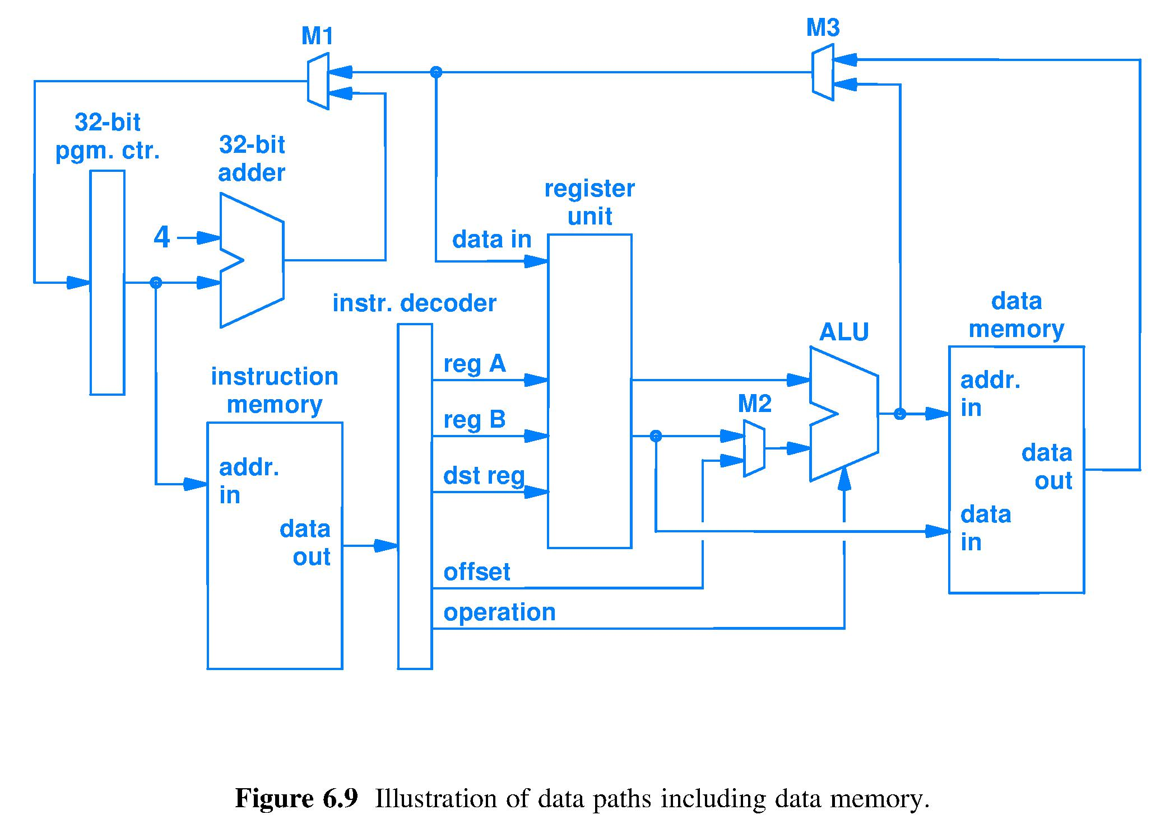
Look for steps within fetch-execute cycle
Observe signals as they propagate through the processor circuit.
Look for a sequence of simple actions that execute an instruction.

Slide 5
1) Fetch an instruction and compute the Default_Next_Instruction_Pointer
← Default_Next_ Instruction_Pointer
Current_Instruction_Pointer →
Fetched
instruction
Fetch using Current_Instruction_Pointer, also known as (a.k.a.) the Program Counter

Slide 6
1) Fetch, 2) Decode instr., access operands, and sign extend offset
Sign extend
Decode, point to, and access registers and sign extend offset. All of this is performed by the circuit regardless of opcode.

Slide 7
1) Fetch, 2) Decode, 3) Execute instr.
Sign extend
ALU and M2 control inputs are functions of Opcode field bits

Slide 8
Fetch, Decode, Ex, 4) access Data Mem
Sign extend
Data Memory (DM) always receives Addr._In and Data_In bit strings. READ_Enable (RE) & WRITE_Enable (WE) DM controls are functions of Opcode. DM reads at Addr._In if RE = true, writes Reg_B_Value at Addr._IN if WE = true, and does nothing if RE = WE = false.

Slide 9
Fetch, Decode, Ex, Mem, 5) Write Back
Sign extend
Bit strings from all sources of results are routed by M3 and M1 to the appropriate destination register (32-bit pgm. ctr. is a register). M3 and M1 control signals are functions of the Opcode.

Slide 10
One-instruction-per-clock-cycle design
Clock
Circuitry put into action by current instruction bits
Long signal paths imply long propagation time, implies long wait for current instruction to complete fetch-execute, implies a long wait until the circuit can fetch the next instruction
The only clocked device,
the PC register
Sign extend

Slide 11
Processor design criteria
Designs should be evaluated against a set of criteria important for the given user, e.g.,
Software compatibility
Performance
Price
Power consumption
…
Which criteria are common to most users?
After software compatibility, users often care next most about performance
Much effort in computer architecture focused on performance and power consumption

Slide 12
Example: time to do laundry
Assume you have:
One washer (takes 30 minutes)
One drier (takes 40 minutes)
One “folder” (takes 20 minutes)
Takes 90 minutes to wash, dry, and fold 1 load of laundry.
How long does it take to do 4 loads?

Slide 13
One-load-at-a-time process (sequential)
6 PM
7
8
9
10
11
Midnight
Time
30
40
20
30
40
20
30
40
20
30
40
20
4 loads done sequentially takes 6 hours
Is there a faster way to process 4 loads?

Slide 14
Laundry pipelining
Overlap the loads – start each new load as soon as possible, given available resources
6 PM
7
8
9
10
11
Midnight
Time
30
40
40
40
40
20
4 loads in 3.5 hours

Slide 15
Pipelining terminology
6 PM
7
8
9
Latency is the time from start to finish to wash one load of clothes
Throughput is the rate at which loads are completed
Pipelining does not decrease latency of a load, pipelining increases throughput when there is a collection of loads
Ideal technique? No Darn good? Yes
Time
30
40
40
40
40
20
1 Thru
Latency

Slide 16
Pipelining key characteristics
Pipelining does not improve execution time of a single task
Every subtask of the full task takes longer to execute than without pipelining because of
slowest subtask in the pipeline delays faster subtasks
possible dependence of one task on a previous task
Pipelining does increase throughput, the amount of work completed per unit time, because multiple tasks are being processed simultaneously
Result is reduced total time for a sequence of tasks
Workload comprised of many tasks is finished sooner because more work is being done simultaneously: there is more parallelism

Slide 17
Pipelining a processor circuit
Hardware implementation technique whereby multiple instructions are overlapped in time
Fetch-Execute cycle can iterate faster than any one instruction can complete
Pipelining is the most basic processor speedup technique
Exploits parallelism (independence) among machine instructions, called instruction level parallelism (ILP)
Easy for programmer to use because not visible to code
Hardware designer issues are
Choose the number of stages
Try for similar propagation delay for each pipeline stage
Focus on throughput – rate of instruction completion

Slide 18
Pipelined design (text Fig. 5.3)
Break the work for one instruction into stages
Change one-instruction-per-clock-cycle design to one-instruction-stage-per-clock-cycle
Overlap as many instructions as there are stages, ideally
Complete all stages every clock cycle, ideally
Non-ideal operation comes from
Stage needs a bit string or a control signal that has not yet reached the stage or does not yet exist
External memory cannot keep pace with stage circuits of the pipelined processor

Slide 19
The secret to completing instructions more rapidly? (Do less per clock cycle)
Break data & control paths into short segments, called stages
Stage starts with register of inputs to combinatorial circuits that compute result of that stage and pass to next register
Orange boxes are the pipeline registers
• Clock speed now limited only by the propagation delay within
the slowest stage, rather than propagation delay of entire circuit

Slide 20
What does each stage do?
IF: Instr. fetch & next_PC
ID: Decode & reg. access
EX:
Execute
MEM: access
Data mem.
WB: Write back (result)
PC
Reg.
IF/ID
Reg.
ID/EX
Reg.
EX/MEM
Reg.
MEM/WB
Reg.

Slide 21
Clocking the stage registers
Rising clock edge loads all stage registers with bits from preceding stage circuits, falling edge transfers these bits to register output, putting circuits of next stage to work

Slide 22
Clocking the stage registers
Rising clock edge loads all stage registers with data from preceding combinatorial circuits, falling edge transfers data to register output, putting combinatorial circuits of next stage to work

